Slide 1






Emerging Skills Report: Insights and Trends in Programming Languages, Databases, Platforms, and Web Frameworks
Divine Jude
February 2023

Slide 2



OUTLINE
Executive Summary
Introduction
Methodology
Results
Visualization – Charts
Dashboard
Discussion
Findings & Implications
Conclusion
Appendix
Resources

Slide 3

EXECUTIVE SUMMARY
The purpose of this report is to provide insights and trends in the field of IT, specifically focusing on the most in-demand programming languages, databases, platforms, and web frameworks.
The data was collected from various sources such as job postings, and surveys.
The data analysis showed that the top 5 programming languages in demand are JavaScript, HTML/CSS, Python, SQL, and Typescript. The leading 5 databases in demand are PostgreSQL, mongo DB, Redis, MySQL, and Elasticsearch. The top 5 platforms in demand are Linux, Docker, AWS, windows, and Android.
These findings have implications for IT professionals and organizations, as they can use this information to upskill themselves and to make informed decisions about the technologies they choose to invest in.

Slide 4

INTRODUCTION
This report provides an in-depth analysis of the emerging skills in the IT industry. It highlights the most in-demand programming languages, databases, platforms, and web frameworks, based on data collected from various sources such as job postings, and surveys.
This report is intended for IT professionals and organizations who are interested in staying up-to-date with the latest technological advancements and identifying the skills that are in demand in the industry.
By reading through this report, the reader will gain a comprehensive understanding of the current trends and patterns in the IT industry and will be able to make informed decisions about their personal and professional development. The report provides valuable insights and recommendations for individuals and organizations looking to upskill and remain competitive in the fast-paced and ever-changing world of technology.

Slide 5

METHODOLOGY
The technology trend is studied by comparing the current and future technology usage. The data was from ‘The 2019 Stack Overflow Developer Survey’.
Process:
Data Collection
Data Wrangling
Exploratory Data Analysis
Data Visualization
Dashboard Creation
Notes:
Data Collection
Collecting Data Using APIs
Collecting Data Using Web scraping
Exploring Data
Data Wrangling
Finding Missing Values
Determine Missing Values
Finding Duplicates
Removing Duplicates
Normalizing Data
Exploratory Data Analysis
Distribution
Outliers
Correlation
Data Visualization
Visualizing Distribution of Data
Relationship
Composition
Comparison
Dashboard Creation
Dashboards

Slide 6

RESULTS
From the result, analysis shows that the top 5 programming languages in demand are:
JavaScript
HTML/CSS
Python
SQL
Typescript
The results consists of 4 main parts:
Programming language trend
Database trend
Platform trend
Web frame trend
Notes:
From the result, analysis shows that the top 5 programming languages in demand are:
JavaScript
HTML/CSS
Python
SQL
Typescript

Slide 7
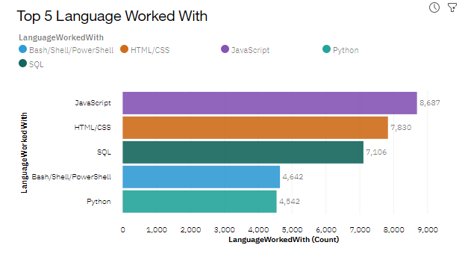
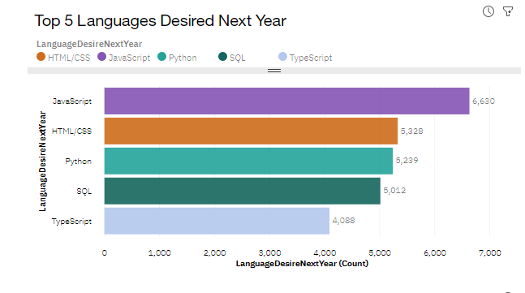
PROGRAMMING LANGUAGE TRENDS
Current Year
Next Year
Notes:
it can suggest the following:
JavaScript is widely used for developing interactive front-end web applications and is in high demand in the industry.
HTML/CSS are the basic building blocks of websites and are still in high demand, indicating that web development is a popular area of expertise.
SQL is a widely used language for managing relational databases and is in high demand, indicating the importance of database management in the industry.
TypeScript is a typed superset of JavaScript, indicating a strong demand for type-safe and scalable web applications.
Python is a general-purpose programming language that is widely used in a variety of applications, from web development to data science, and is in high demand, indicating its versatility and popularity.
These results can help the organization make informed decisions about their future skill requirements and help individuals understand the popular programming skills that are currently in demand.

Slide 8
PROGRAMMING LANGUAGE TRENDS - FINDINGS & IMPLICATIONS
Findings
JavaScript is widely used for developing interactive front-end web applications and is in high demand in the industry.
HTML/CSS are the basic building blocks of websites and are still in high demand, indicating that web development is a popular area of expertise.
Python is a general-purpose programming language that is widely used in a variety of applications, from web development to data science, and is in high demand, indicating its versatility and popularity
SQL is a widely used language for managing relational databases and is in high demand, indicating the importance of database management in the industry.
Implications
The results can help the organization identify the skills they need to invest in to remain competitive in the market and meet the current and future demands of the industry
The results can help individuals understand the popular programming skills that are currently in demand and guide them in their career development and skill acquisition
For the industry: The results can provide a snapshot of the current demand for programming skills and help stakeholders in the industry understand the trends and make informed decisions about their investments in technology and human resource

Slide 9
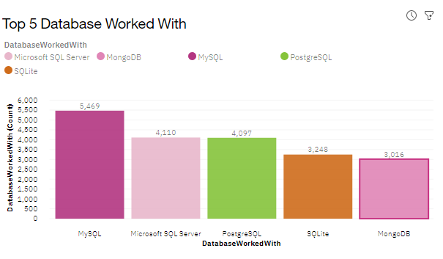
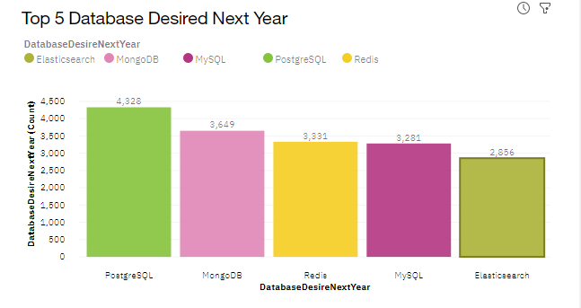
DATABASE TRENDS
Current Year
Next Year

Slide 10
DATABASE TRENDS - FINDINGS & IMPLICATIONS
Finding
PostgreSQL is an open-source relational database management system and is in high demand, indicating the popularity of open-source solutions and the need for advanced data management capabilities.
MongoDB is a NoSQL database that is widely used for developing scalable and flexible web applications and is in high demand, indicating the growth of the web development industry and the need for flexible data storage solutions.
Redis is an in-memory data structure store that is widely used for caching, real-time analytics, and message brokering and is in high demand, indicating the need for fast and efficient data processing solutions.
Implications
The results can help the organization identify the databases they need to invest in to remain competitive in the market and meet the current and future demands of the industry.
Individuals can use the results to identify areas they need to improve their skills in and make informed decisions about their future training
The results can also help the industry predict future technology requirements and identify emerging databases that may gain popularity in the future

Slide 11
DASHBOARD
Click here to view the stack overflow developer survey dashboard

Slide 12
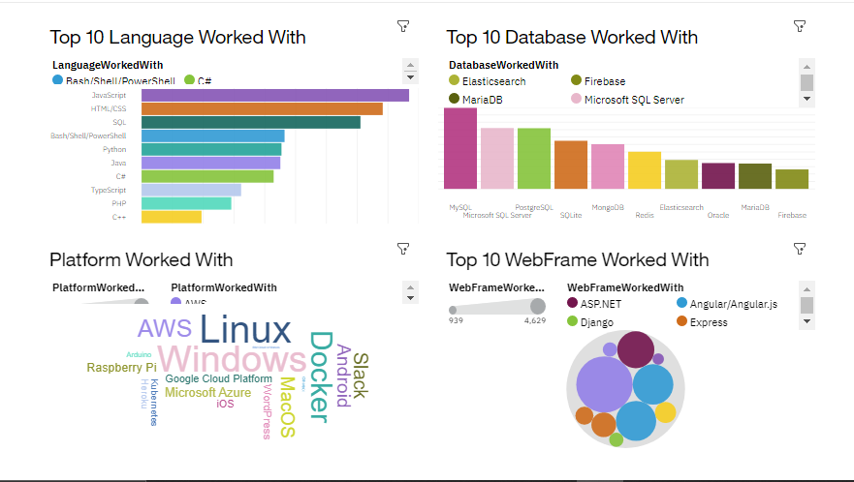
DASHBOARD TAB 1

Slide 13
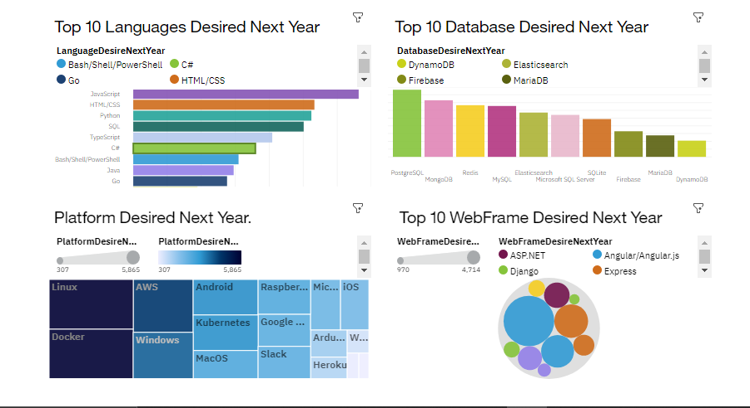
DASHBOARD TAB 2

Slide 14
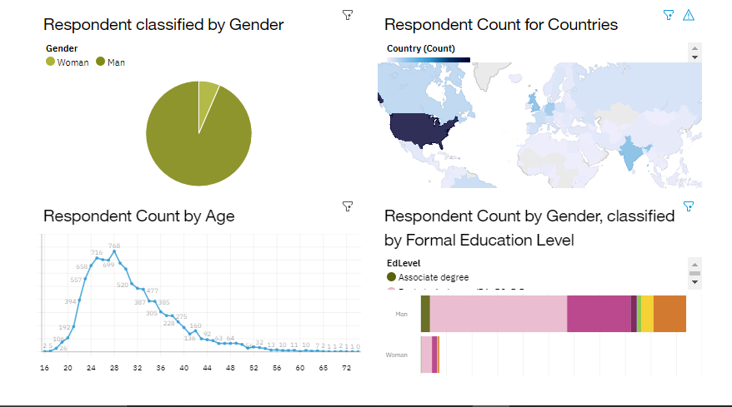
DASHBOARD TAB 3

Slide 15
DISCUSSION
The overall findings and implications of the analysis of the demand for programming languages and database skills can have a significant impact on the IT industry and the individuals working in it.

Slide 16
OVERALL FINDINGS & IMPLICATIONS
Findings
The analysis provides a comprehensive view of the programming languages and database skills that are in high demand and the trends in the industry. The results can help the organization and individuals understand the skills that are currently in demand and the ones that are likely to grow in popularity in the future
Implications
The results of the analysis can have several implications for both the organization and individuals in the industry.
For the organization, the results can help them make informed decisions about their future technology investments and prioritize their technology projects based on the skills that are in high demand.
For individuals, the results can help them understand the skills they need to acquire or improve to remain competitive in the industry and advance their careers.

Slide 17

CONCLUSION
Programming Language Trend: The results show that JavaScript, HTML/CSS, Python, SQL, and Typescript are the top 5 programming languages in demand. This indicates that the industry has a high demand for front-end and back-end development skills, as well as data analysis and management skills.
Database Trend: The results show that PostgreSQL, mongo DB, Redis, MySQL, and Elasticsearch are the top 5 databases in demand. This highlights the growing importance of data management and big data technologies in the industry.
Platform Trend: The results show that Linux, Docker, AWS, windows, and Android are the top 5 platforms that developers are working with. This highlights the versatility and adaptability of developers to work with different platforms and technologies.
Web Framework Trend: The results show that React.js, Vue.js, Angular/Angular.js, APS.Net, and jQuery are the top 5 web frameworks desired next year. This highlights the growing importance of front-end development skills and the need for developers to be proficient in building dynamic and user-friendly websites.

Slide 18
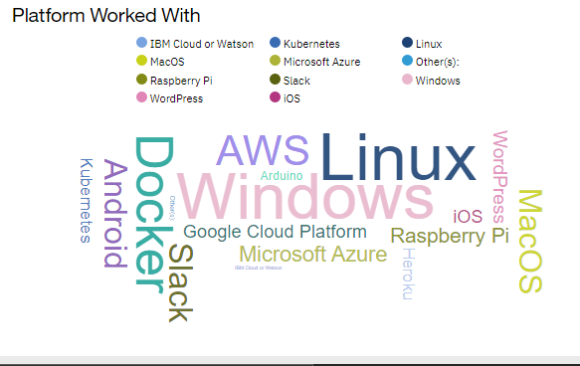
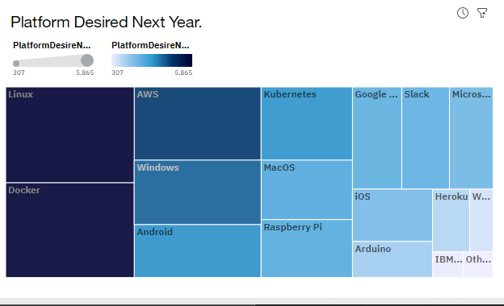
APPENDIXS
Current Year
Next Year

Slide 19
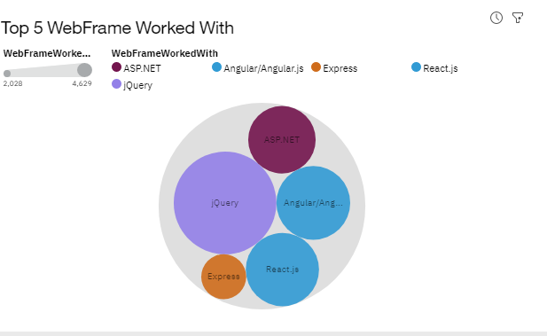
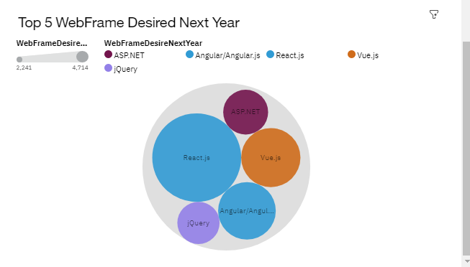
ADDITIONAL VISUALS
Current Year
Next Year

Slide 20
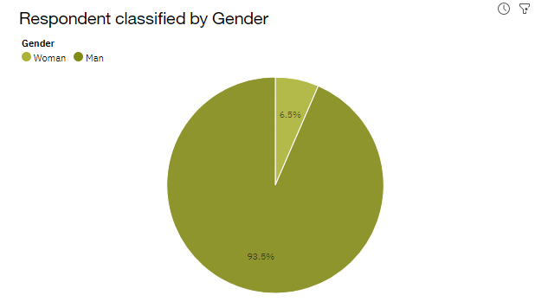
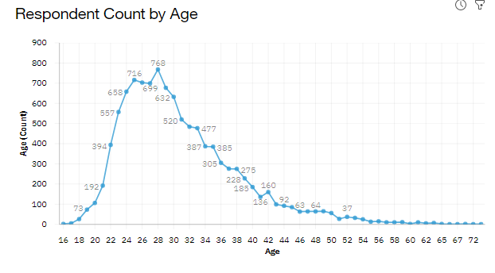
ADDITIONAL VISUALS

Slide 21
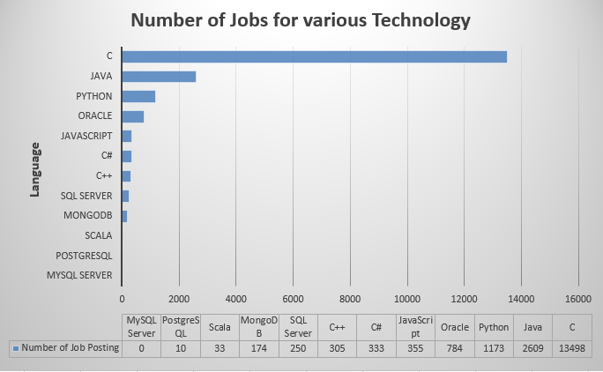
JOB POSTINGS

Slide 22
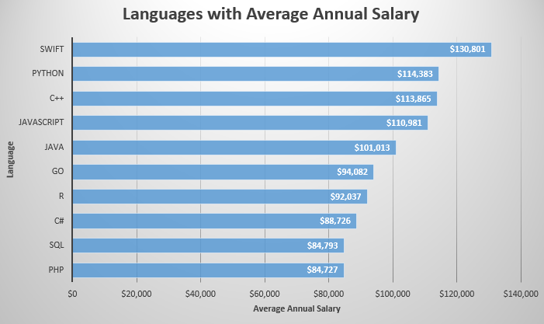
POPULAR LANGUAGES

Slide 23
RECOMMEDATIONS
Development of cross-functional team training programs that focus on equipping developers with knowledge of the top programming languages, databases, platforms and web frameworks. This will help organizations stay ahead of the curve and attract top talent.
Creation of cloud-based development environments that allow developers to experiment with the latest technologies, including the top programming languages, databases, platforms and web frameworks.

Slide 24
RESOURCES
The 2019 Stack Overflow Developer Survey Dataset
JOBS API
Popular Programming Languages
m5_survey_data_technologies_normalised
m5_survey_data_demographics

Slide 25
The tech industry is constantly evolving and staying ahead of the curve is crucial! Our latest data analysis shows that JavaScript, HTML/CSS, Python, SQL, and Typescript are the top programming languages in demand. Meanwhile, PostgreSQL, MongoDB, Redis, MySQL, and Elasticsearch lead the way in database skills. And, if you want to keep up with the latest platforms, Linux, Docker, AWS, Windows, and Android are the ones to watch. Finally, React.js, Vue.js, Angular/Angular.js, ASP. Net, and jQuery are the web frameworks shaping the future of the web. Stay ahead of the game and brush up on these skills today!

Slide 26
Thank you!
ANY QUESTIONS?

